Slide 1


Secure Software Coding Practice
Training Date : 5th Sept 2018
Plot No: 94, Sector – 32, Institutional Area,
Gurgaon – 122006. Haryana (India)
www.mpowersoft.com
Copyright@2014 MPower Softcomm Pvt. Ltd. | All Rights Reserved.

Slide 2
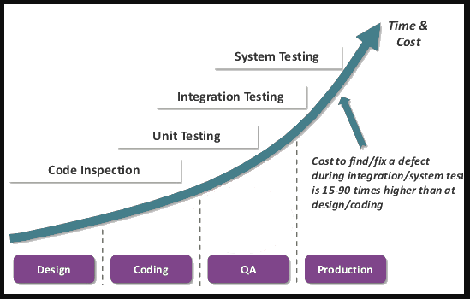
Secure Coding Vs Security Testing/Fixing

Slide 3
OWASP 2013 Top Ten List
A1 Injection
A2 Broken Authentication and Session Management
A3 Cross-Site Scripting (XSS)
A4 Insecure Direct Object References
A5 Security Misconfiguration
A6 Sensitive Data Exposure
A7 Missing Function Level Access Control
A8 Cross-Site Request Forgery (CSRF)
A9 Using Components with Known Vulnerabilities
A10 Unvalidated Redirects and Forwards

Slide 4
A1. Injections Flaws
OWASP Definition:
Injection flaws, particularly SQL injection, are common in web applications. Injection occurs when user-supplied data is sent to an interpreter as part of a command or query. The attacker’s hostile data tricks the interpreter into executing unintended commands or changing data.

Slide 5
A1. Injections Flaws
Some common types of command injection flaws include:
SQL injection (malicious calls to backend databases via SQL), using shell commands to run external programs
Using system calls to in turn make calls to the operating system.
Any Web application that relies on the use of an interpreter has the potential to fall victim to this type of flaw

Slide 6
Injections Flaws : Protection
Use language specific libraries to perform the same functions as shell commands and system calls
Check for existing reusable libraries to validate input, and safely perform system functions, or develop your own.
Perform design and code reviews on the reusable libraries to ensure security.
Other common methods of protection include:
Use stored Procedures
Data validation (to ensure input isn't malicious code),
Run commands with very minimal privileges
If the application is compromised, the damage will be minimized.

Slide 7
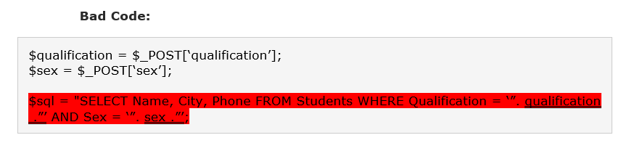
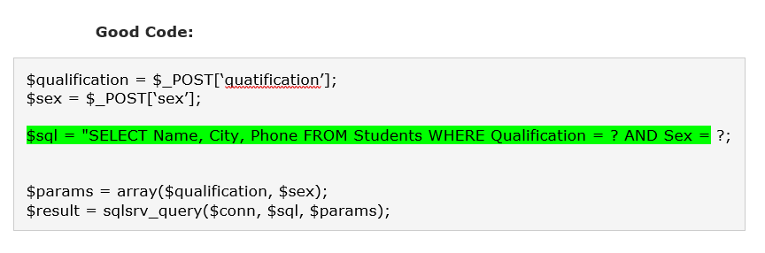

Slide 8
A2. Broken Authentication and Session Management
OWASP Definition:
Account credentials and session tokens are often not properly protected. Attackers compromise passwords, keys, or authentication tokens to assume other users’ identities.

Slide 9
Session Management
HTTP/S protocol does not provide tracking of a users session.
Session tracking answers the question:
After a user authenticates how does the server associate subsequent requests to the authenticated user?
Typically, web application vendors provide a built-in session tracking, which is good if used properly.
Often developers will make the mistake of inventing their own session tracking.

Slide 10
Session Management: Protection
Entire session should be transmitted via HTTPS to prevent disclosure of the session ID. (Not just the authentication)
Avoid or protect any session information transmitted to/from the client.
Session ID should expire and/or time-out on the Server when idle or on logout.
Client side cookie expirations are useful, but should not be trusted.
Consider regenerating a new session upon successful authentication or privilege level change.
Notes:
Example Session ID using cookie
Set-Cookie: siteid=91d3dc13713aa579d0f148972384f4; path=/; expires=Wednesday, 22-Oct-2006 02:12:40 domain=.www.rd1.net
secure
Cookie: siteid=91d3dc13713aa579d0f148972384f4

Slide 11
Broken Account Management
Even valid authentication schemes can be undermined by flawed account management functions including:
Account update
Forgotten password recovery or reset
Change password, and other similar functions

Slide 12
A3. Cross-Site Scripting (XSS) Flaws
OWASP Definition:
XSS flaws occur whenever an application takes user supplied data and sends it to a web browser without first validating or encoding that content. XSS allows attackers to execute script in the victim's browser which can hijack user sessions, deface web sites, possibly introduce worms, etc.

Slide 13
A3. Cross-Site Scripting (XSS) Attacks
3 Categories of XSS attacks:
Stored - the injected code is permanently stored (in a database, message forum, visitor log, etc.)
Reflected - attacks that are reflected take some other route to the victim (through an e-mail message, or bounced off from some other server)
DOM injection – Injected code manipulates sites javascript code or variables, rather than HTML objects.

Slide 14
A3. Cross-Site Scripting (XSS)
Occurs when an attacker can manipulate a Web application to send malicious scripts to a third party.
This is usually done when there is a location that arbitrary content can be entered into (such as an e-mail message, or free text field for example) and then referenced by the target of the attack.
The attack typically takes the form of an HTML tag (frequently a hyperlink) that contains malicious scripting (often JavaScript).
The target of the attack trusts the Web application and thus XSS attacks exploit that trust to do things that would not normally be allowed.
The use of Unicode and other methods of encoding the malicious portion of the tag are often used so the request looks less suspicious to the target user or to evade IDS/IPS.
Notes:
Some good video tutorials about how this attack is executed: http://www.virtualforge.de/vmovie.php

Slide 15
Cross Site Scripting - Protection
Protect your application from XSS attacks
Filter output by converting text/data which might have dangerous HTML characters to its encoded format:
'<' and '>' to '&lt;' and '&gt;’
'(' and ')' to '&#40;' and '&#41;’
'#' and '&' to '&#35;' and '&#38;‘
Recommend filtering on input as much as possible. (some data may need to allow special characters.)

Slide 16
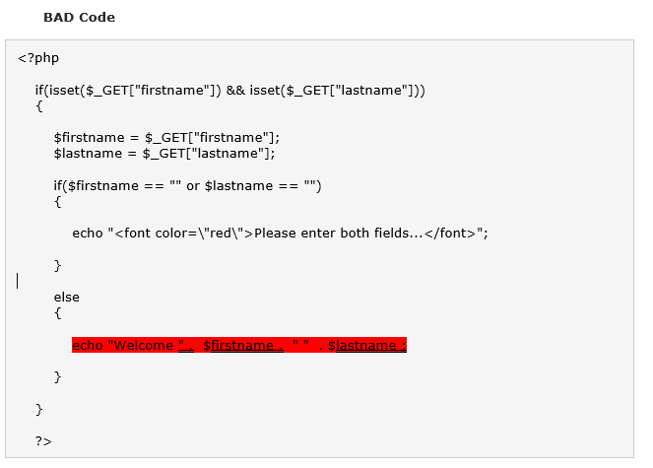
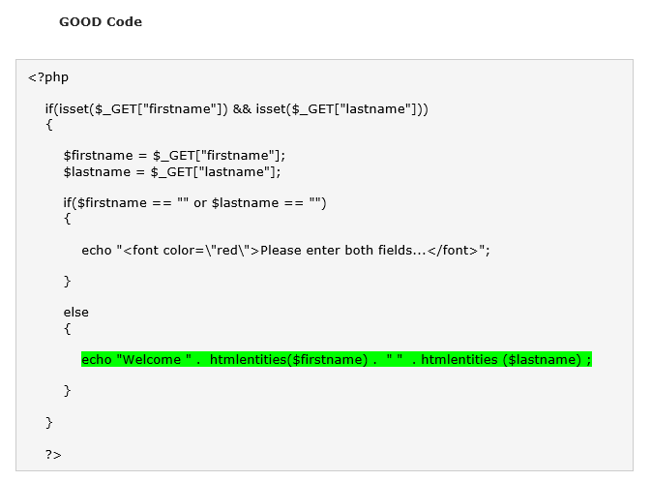

Slide 17
A4. Insecure Direct Object Reference
OWASP Definition:
A direct object reference occurs when a developer exposes a reference to an internal implementation object, such as a file, directory, database record, or key, as a URL or form parameter. Attackers can manipulate those references to access other objects without authorization.

Slide 18
A4. Insecure Direct Object Reference
Applications often expose internal objects, making them accessible via parameters.
When those objects are exposed, the attacker may manipulate unauthorized objects, if proper access controls are not in place.
Internal Objects might include
Files or Directories
URLs
Database key, such as acct_no, group_id etc.
Other database object names such as table name

Slide 19
A4. Insecure Direct Object Reference
Do not expose direct objects via parameters
Use an indirect mapping which is simple to validate.
Consider using a mapped numeric range, file=1 or 2 …
Re-verify authorization at every reference.
For example:
Application provided an initial lists of only the authorized options.
When user’s option is “submitted” as a parameter, authorization must be checked again.

Slide 20
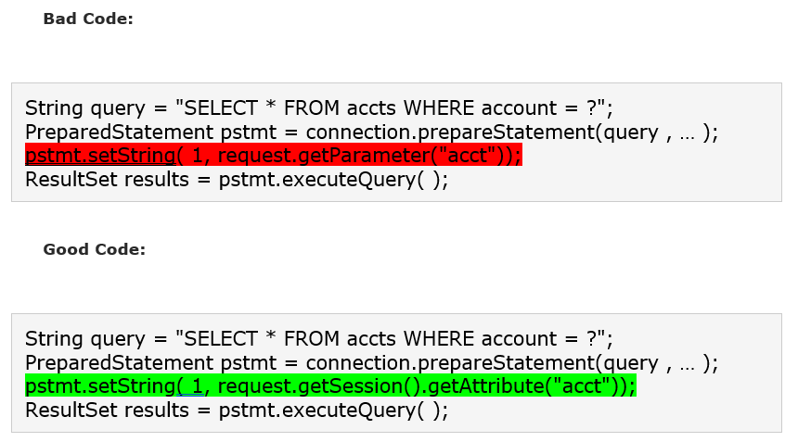

Slide 21
A5. Security Misconfiguration
OWASP Definition:
Good security requires having a secure configuration defined and deployed for the application, frameworks, application server, web server, database server, and platform. Secure settings should be defined, implemented, and maintained, as defaults are often insecure. Additionally, software should be kept up to date.

Slide 22
Security Misconfiguration: Protection
Disable default accounts
Never use default credentials for authentication
Never expose internal resources to public
Error handling should be configured securely
No detailed error message should be visible to user
Server and framework component versions should not be visible to user

Slide 23
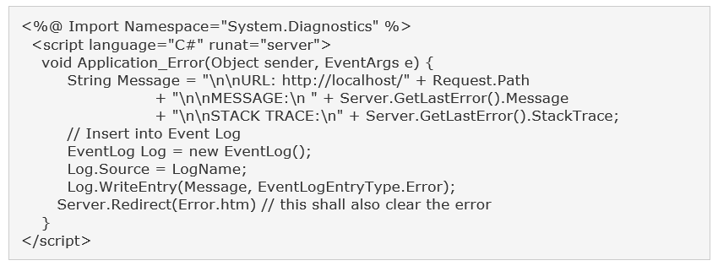

Slide 24
A6. Sensitive Data Exposure
OWASP Definition:
Many web applications do not properly protect sensitive data, such as credit cards, tax IDs, and authentication credentials. Attackers may steal or modify such weakly protected data to conduct credit card fraud, identity theft, or other crimes. Sensitive data deserves extra protection such as encryption at rest or in transit, as well as special precautions when exchanged with the browser.

Slide 25
Sensitive Data Exposure : Protection
Sensitive data should be stored with strong encryption.
Data should be sent only on encrypted communication channel (TLS 1.1 or later)

Slide 26
A7. Missing Function Level Access Control
OWASP Definition:
Frequently, an application only protects sensitive functionality by preventing the display of links or URLs to unauthorized users. Attackers can use this weakness to access and perform unauthorized operations by accessing those URLs directly. Attackers can also manipulate browser cookie and gain higher privileges into the system.

Slide 27
Missing Function Level Access Control : Protection
Document user roles as well as what functions and content each role is authorized to access.
Perform Authorization check every time user request for some action.

Slide 28
A8. Cross Site Request Forgery (CSRF)
OWASP Definition:
Cross-Site Request Forgery (CSRF) is an attack that forces an end user to execute unwanted actions on a web application in which they're currently authenticated. CSRF attacks specifically target state-changing requests

Slide 29
A8. Cross Site Request Forgery (CSRF)
Applications are vulnerable if any of following:
Does not re-verify authorization of action
Default login/password will authorize action
Action will be authorized based only on credentials which are automatically submitted by the browser such as session cookie, Kerberos token, basic authentication, or SSL certificate etc.

Slide 30
Cross Site Request Forgery (CSRF) Protection
Eliminate any Cross Site Scripting vulnerabilities
Not all CSRF attacks require XSS
However XSS is a major channel for delivery of CSRF attacks
Generate unique random tokens for each form or URL, which are not automatically transmitted by the browser.
Do not allow GET requests for sensitive actions.
For sensitive actions, re-authenticate or digitally sign the transaction.

Slide 31
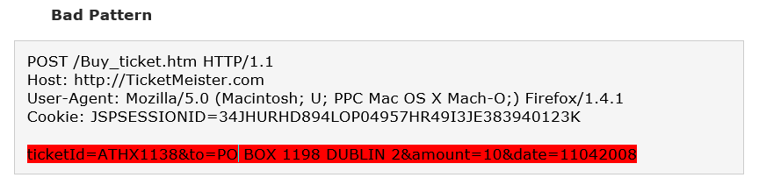
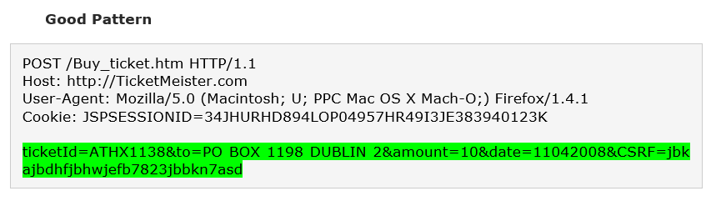

Slide 32
A9. Using Components with Known Vulnerability
OWASP Definition:
Vulnerable components, such as libraries, frameworks, and other software modules almost always run with full privilege. So, if exploited, they can cause serious data loss or server takeover. Applications using these vulnerable components may undermine their defenses and enable a range of possible attacks and impacts.

Slide 33
Using Components with known vulnerability : Protection
Identify all components and the versions you are using, including all dependencies. (e.g., the versions plugin).
Monitor the security of these components in public databases, project mailing lists, and security mailing lists, and keep them up to date.
Establish security policies governing component use, such as requiring certain software development practices, passing security tests, and acceptable licenses.
Where appropriate, consider adding security wrappers around components to disable unused functionality and/ or secure weak or vulnerable aspects of the component.

Slide 34
A10. Unvalidated Redirect and Forward
OWASP Definition:
Unvalidated redirects and forwards are possible when a web application accepts untrusted input that could cause the web application to redirect the request to a URL contained within untrusted input

Slide 35
Unvalidated Redirect and Forward : Protection
Safe use of redirects and forwards can be done in a number of ways:
Simply avoid using redirects and forwards.
If used, don’t involve user parameters in calculating the destination. This can usually be done.
If destination parameters can’t be avoided, ensure that the supplied value is valid, and authorized for the user.
Sanitize input by creating a list of trusted URL's (lists of hosts or a regex).
Force all redirects to first go through a page notifying users that they are going off of your site, and have them click a link to confirm.

Slide 36
Secure Coding Practices

Slide 37
Input Validation
Assume All Input Is Malicious
Centralize Your Approach
Sanitize input for bad characters
If special Characters are allowed in input make sure it is encoded while storing

Slide 38
Authentication
Are user names and passwords sent in plaintext over an insecure channel ?
How is the authenticated user identified after the initial logon ?
How are the credentials stored ?
How are the credentials verified ?

Slide 39
Authorization
Use multiple gatekeepers
Restrict user access to system-level resources
Consider authorization granularity

Slide 40
Session Management
Use SSL to protect session authentication cookies
Encrypt the contents of the authentication cookies
Limit session lifetime
Protect session state from unauthorized access

Slide 41
Parameter Manipulation
Encrypt sensitive cookie state
Make sure that users do not bypass your checks
Validate all values sent from the client
Do not trust HTTP header information

Slide 42
Exception Management
Do not leak information to the client
Log detailed error messages
Catch exceptions

Slide 43
Secure Code Review
Security code review is a method of assuring that application developers are following secure development techniques. A general rule of thumb is that a penetration test should not discover any additional application vulnerabilities relating to the developed code after the application has undergone a proper security code review.
Code review is a way of ensuring that the application has been developed so as to be “self-defending” in its given environment.
Few of the Open Source Secure Code Review Tools are:
SonarQube : More than 20 Languages
Visual Code Grepper : C/C++, C#, VB, PHP, Java, and PL/SQL
PUMA Scan : .Net C#

Slide 44
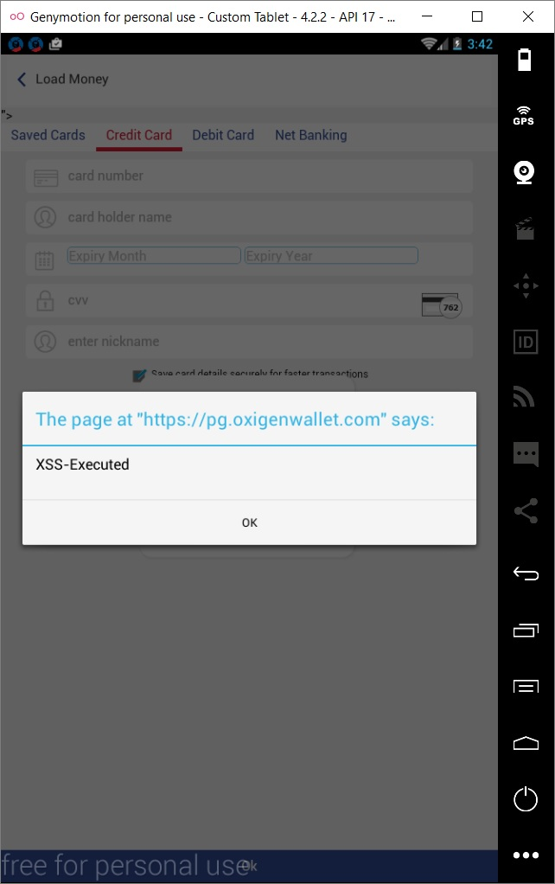
Live/UAT Issues Identified in the Oxigen Developments: XSS

Slide 45
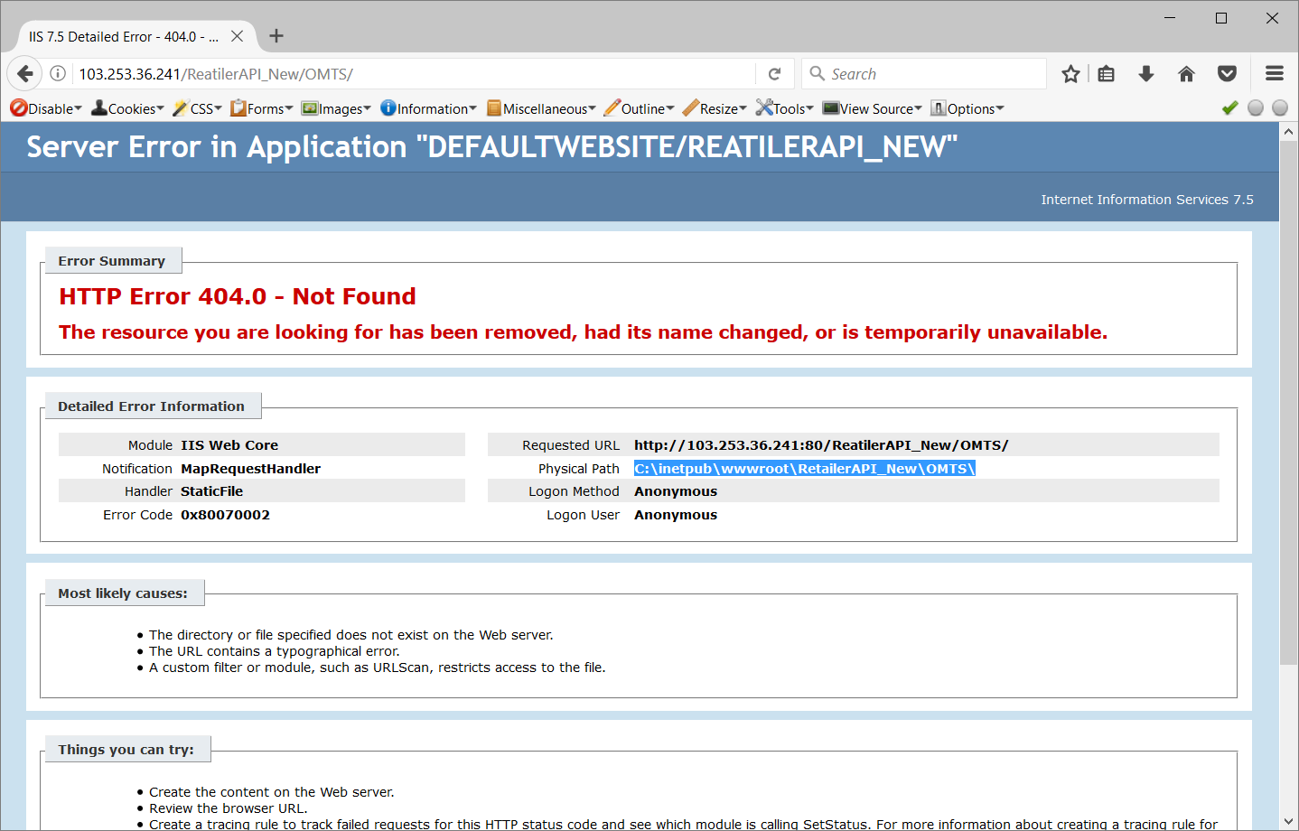
Security Misconfiguration

Slide 46
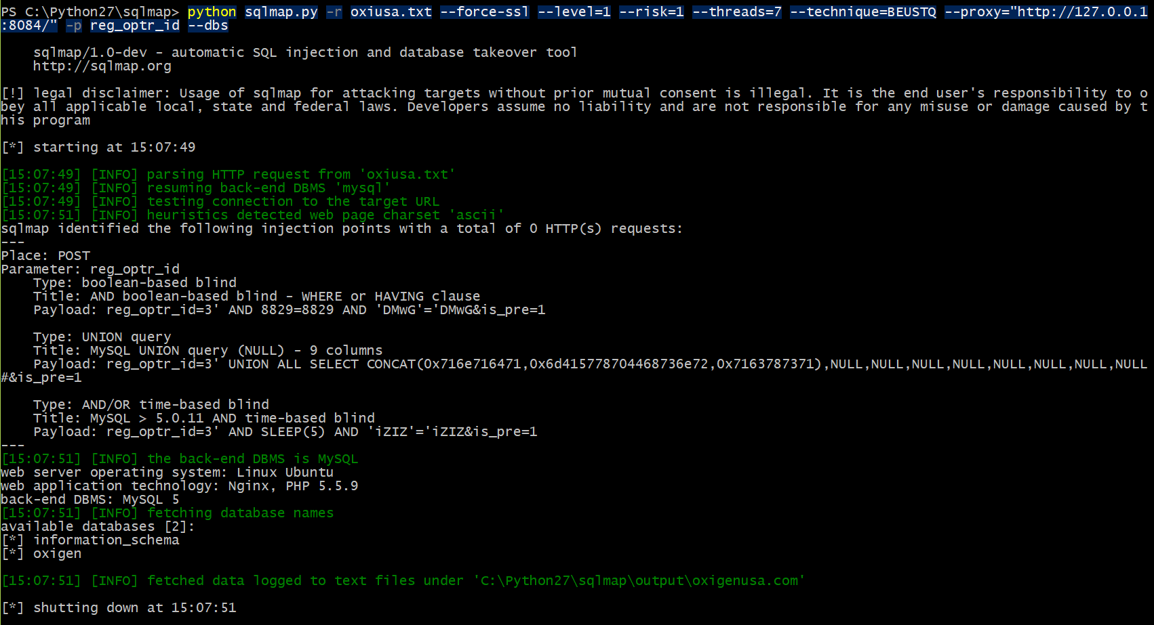
Blind SQL Injection

Slide 47
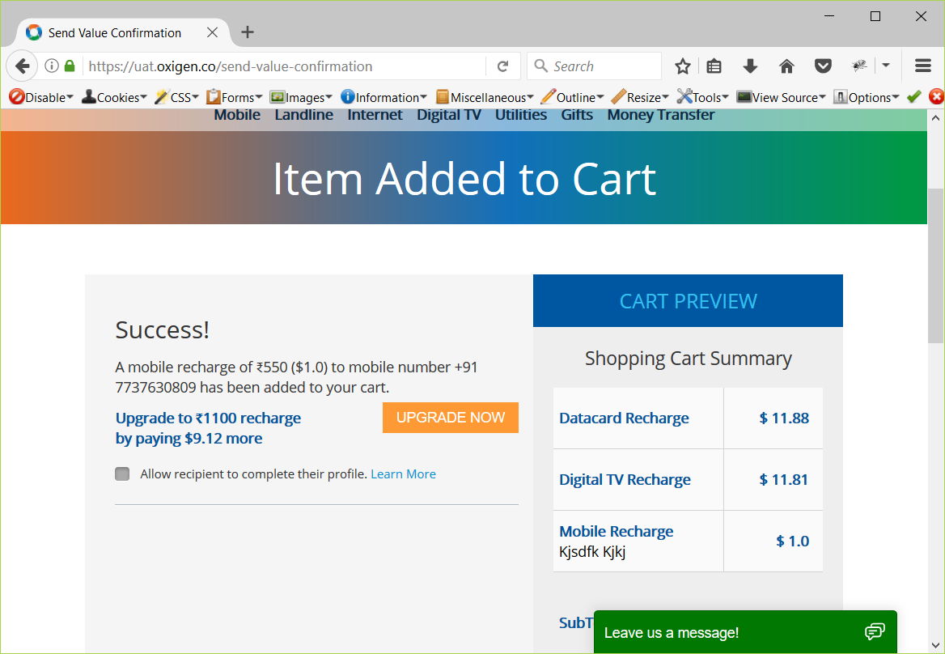
Parameter Tampering

Slide 48
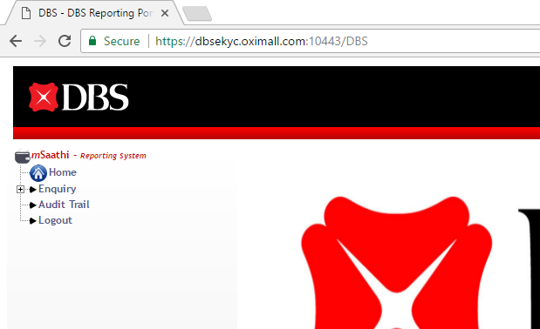
Default Account

Slide 49
Any Queries?

Slide 50
! Quiz Time !
Copyright@2014 MPower Softcomm Pvt. Ltd. | All Rights Reserved.

